Slide 1

AI Furnace Model Review 13/05/2021
Dr. Peter Green
Diego Echeverria
Sarini Jayasinghe
School of Engineering

Slide 2
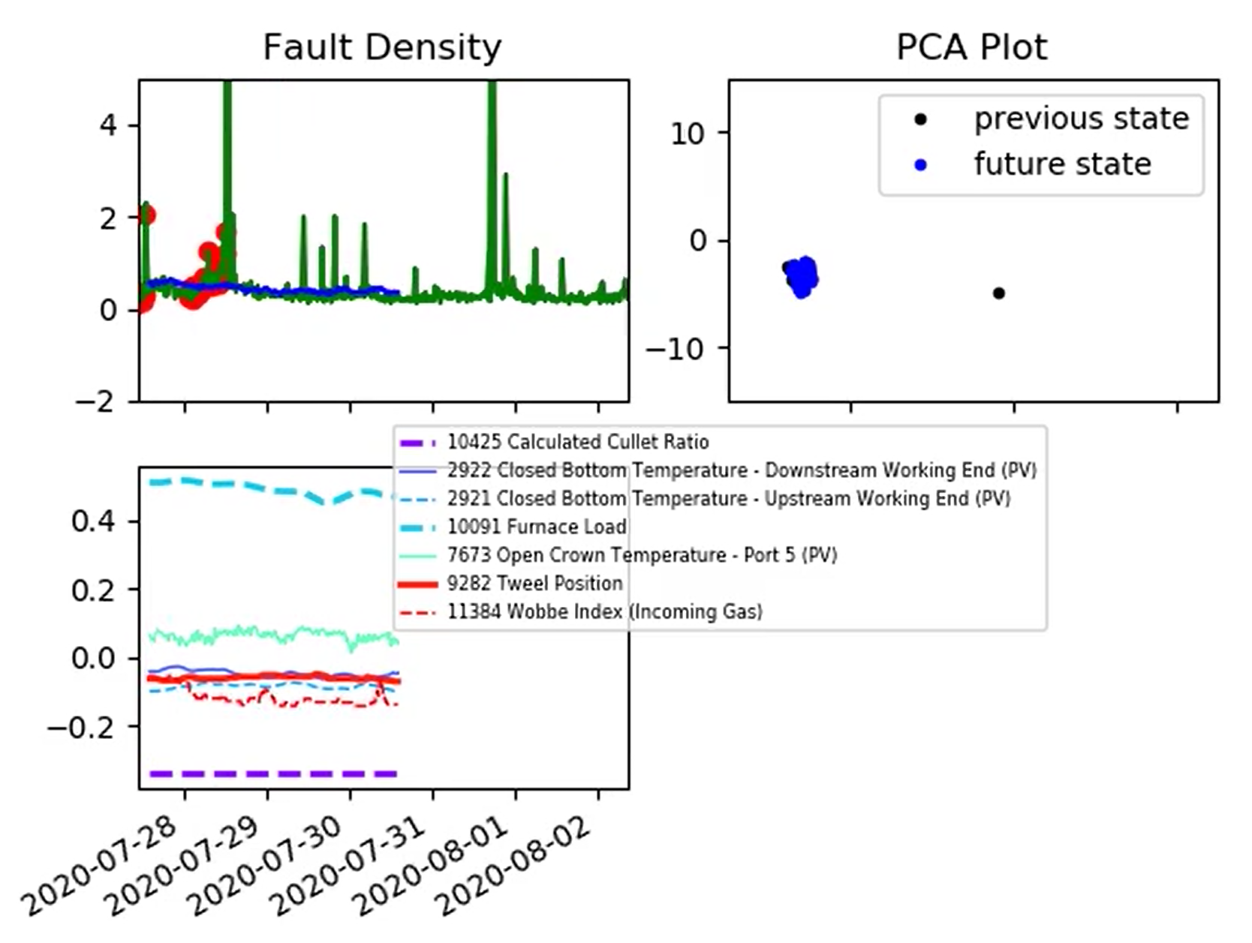
Model Presentation

Slide 3
Model Inputs - display
This plot shows the inputs that are currently of highest significance.
The model’s predictions are created by a summation of these signals.

Slide 4
Model Inputs – list (1)
Input | Time Lag (hours)
Calculated Cullet Ratio | 24
Canal Temp. Control Pyrometer (2) | 2
Canal Temp. Control (PV) | 2
Closed Bottom Temperature - Downstream Working End (PV) | 2
Closed Bottom Temperature - Port 1 (PV) | 24
Closed Bottom Temperature - Port 6 (PV) | 20
Closed Bottom Temperature - Upstream Working End (PV) | 24
Combustion Air Temperature Measurement | 12
Furnace Load | 2
Furnace Pressure (PV) | 4
Open Crown Temperature - Port 1 (PV) | 24
Open Crown Temperature - Port 2 (PV) | 24
Open Crown Temperature - Port 5 (PV) | 24
Open Crown Temperature - Port 6 (PV) | 18

Slide 5
Model Inputs – list (2)
Input | Time Lag (hours)
Open Crown Temperature - Upstream Refiner (PV) | 12
Open Crown Temperature - Upstream Working End (PV) | 3
Port 2 Gas Flow (SP) | 24
Regenerator Base Temperature Port 1 (combined) | 36
Regenerator Base Temperature Port 2 (combined) | 36
Regenerator Base Temperature Port 3 (combined) | 36
Regenerator Base Temperature Port 4 (combined) | 36
Regenerator Base Temperature Port 5 (combined) | 36
Regenerator Base Temperature Port 6 (combined) | 36
Regenerator Base Temperature Port 7 (combined) | 36
Regenerator Crown Temperature Port 2 (combined) | 36
Regenerator Crown Temperature Port 8 (combined) | 36
Tweel Position | 2
Wobbe Index (Incoming Gas) | 12

Slide 6
Model Inputs – list (2)
Input | Time Lag (hours)
Open Crown Temperature - Upstream Refiner (PV) | 12
Open Crown Temperature - Upstream Working End (PV) | 3
Port 2 Gas Flow (SP) | 24
Regenerator Base Temperature Port 1 (combined) | 36
Regenerator Base Temperature Port 2 (combined) | 36
Regenerator Base Temperature Port 3 (combined) | 36
Regenerator Base Temperature Port 4 (combined) | 36
Regenerator Base Temperature Port 5 (combined) | 36
Regenerator Base Temperature Port 6 (combined) | 36
Regenerator Base Temperature Port 7 (combined) | 36
Regenerator Crown Temperature Port 2 (combined) | 36
Regenerator Crown Temperature Port 8 (combined) | 36
Tweel Position | 2
Wobbe Index (Incoming Gas) | 12

Slide 7
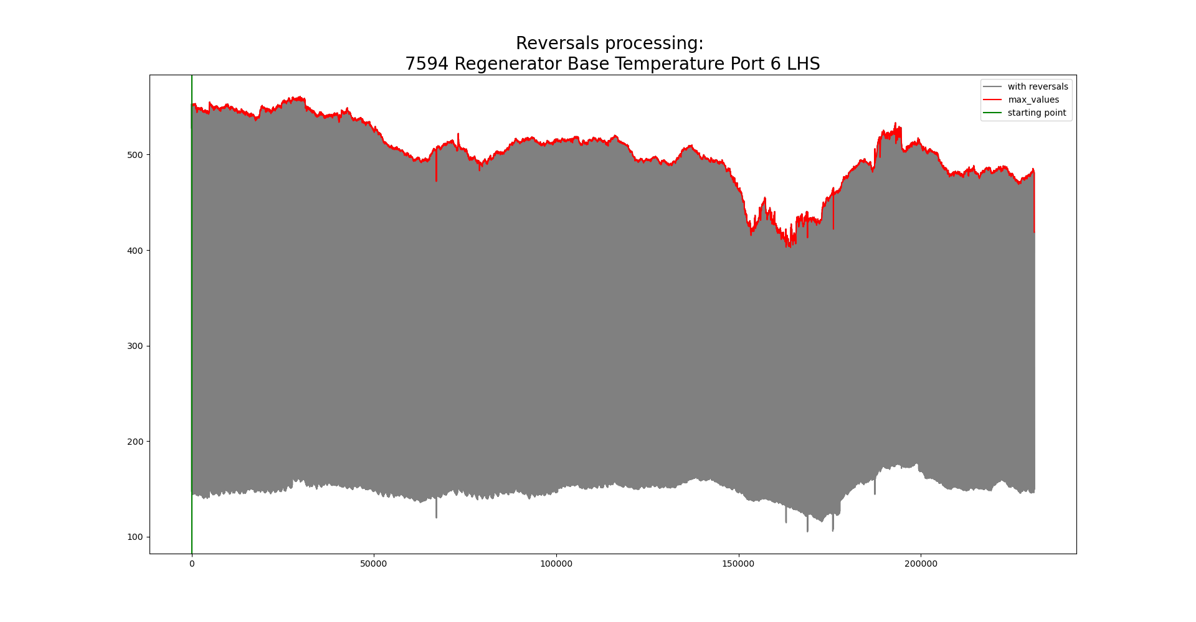
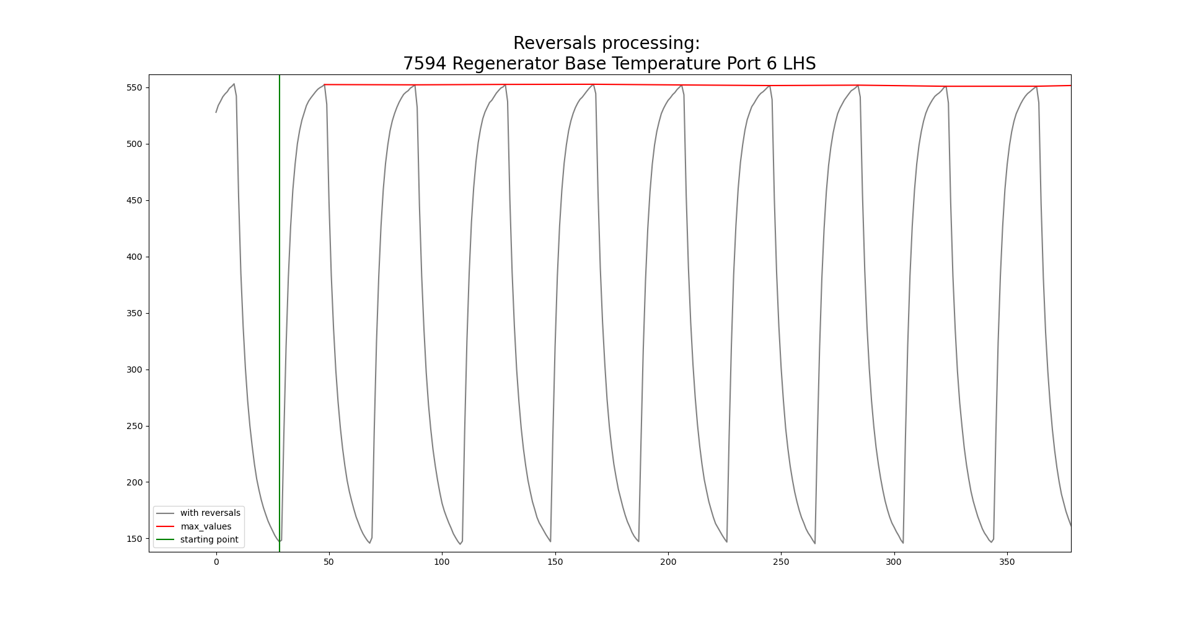
Model Inputs – combination signals

Slide 8
Model Inputs – coating periods
The red circles indicate data points that are ignored by the model.
We believe that these points are associated with coating periods.

Slide 9
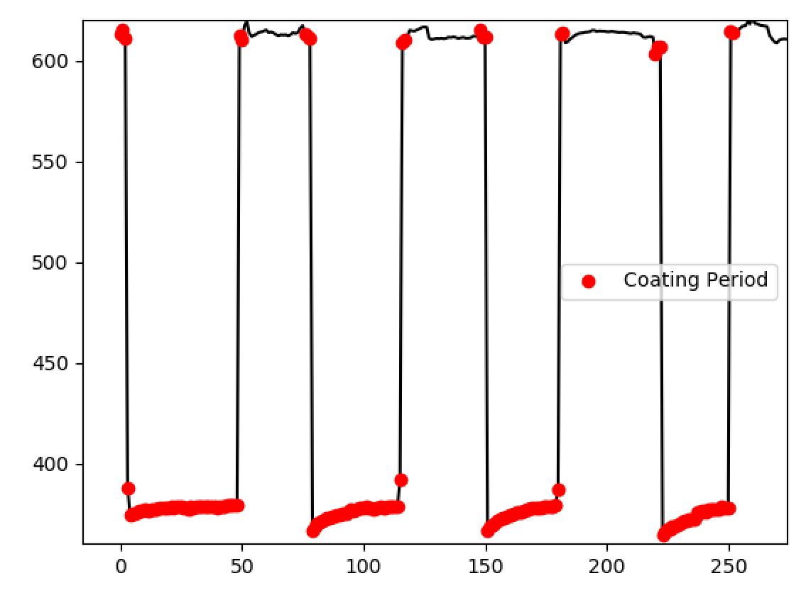
Model Inputs – coating periods
Coating periods are identified using drops in bath pressure.
Bath Pressure

Slide 10
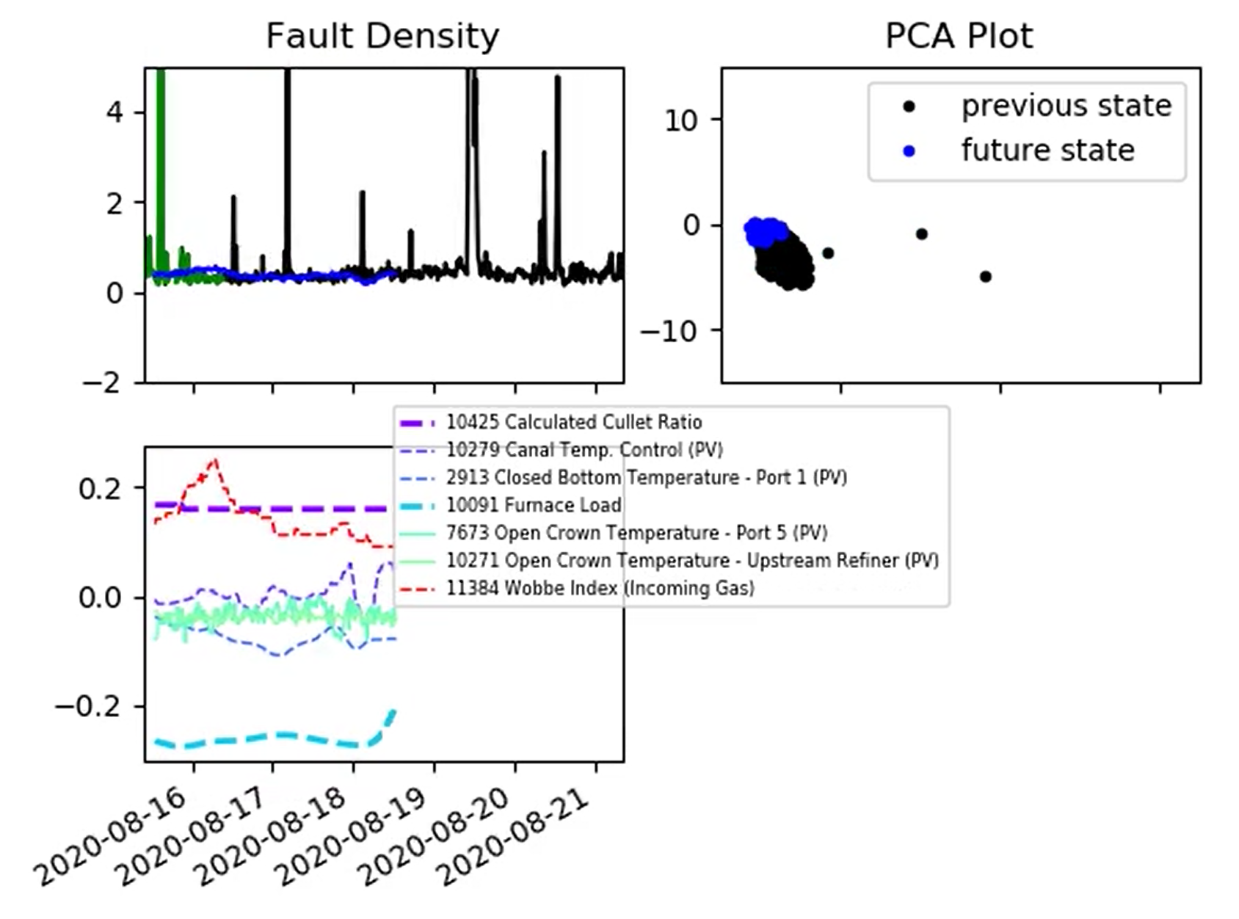
Furnace State – training and testing data
Moving from green to red; the model is now being applied on data that it has not seen before.
It must now adapt to any changes in furnace state.

Slide 11
Furnace State – PCA plot
To illustrate when the model is being applied in a previously unseen state, we developed this ‘PCA plot’.
The PCA plot is a representation of the furnace state (where black dots illustrate previous states).

Slide 12
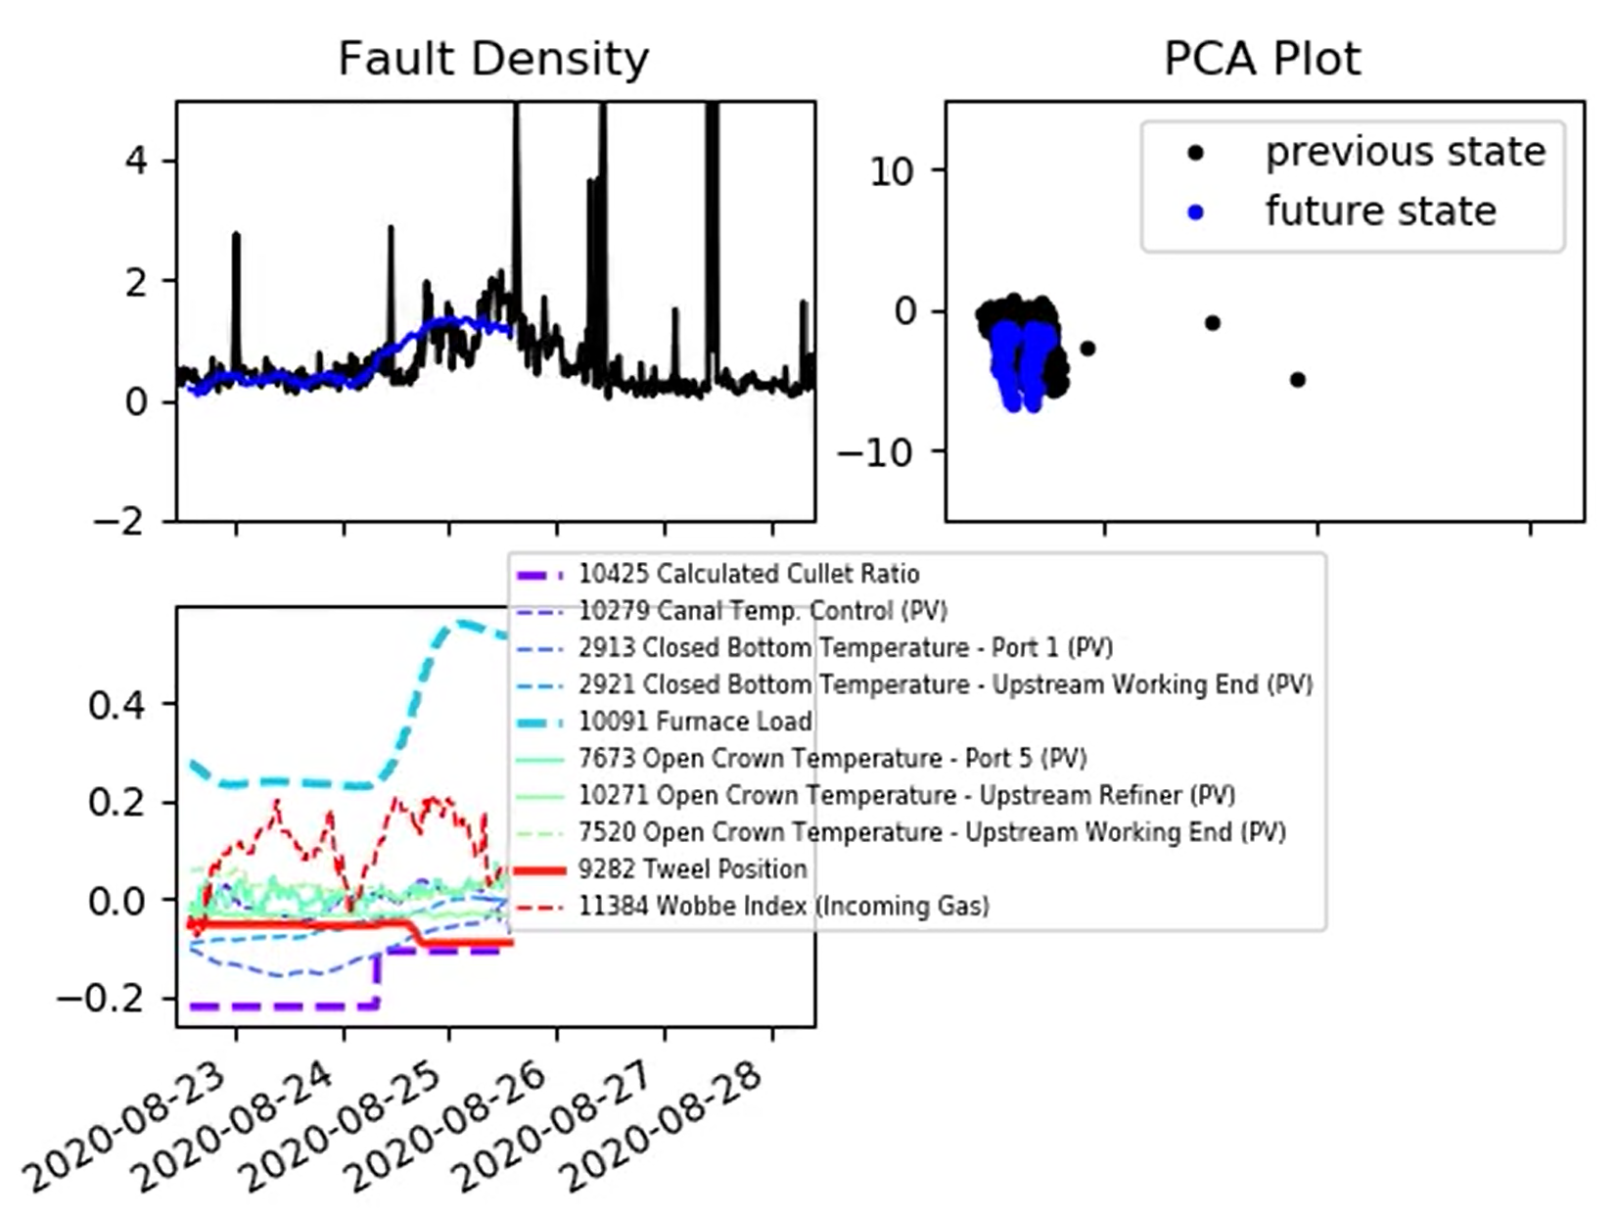
Furnace State – PCA plot
Here a change in furnace load is pushing the furnace into a different state.
The model is initially able to capture the rise in fault density that occurs, but is then pushed beyond data it has seen before and has to adapt as a result.

Slide 13
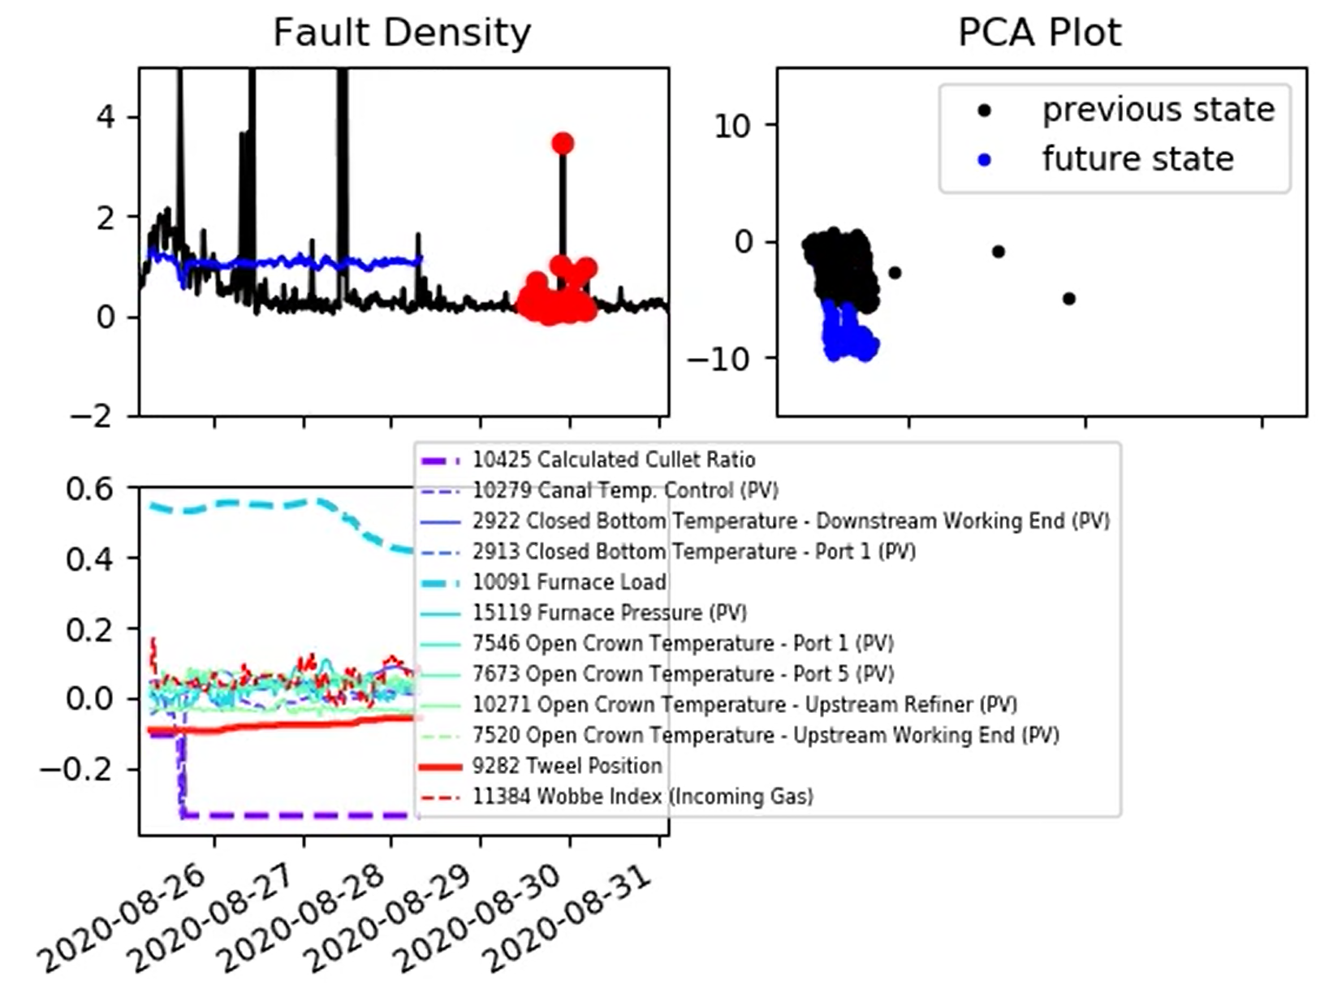
Furnace State – PCA plot
Here a change in furnace load is pushing the furnace into a different state.
The model is initially able to capture the rise in fault density that occurs, but is then pushed beyond data it has seen before and has to adapt as a result.

Slide 14
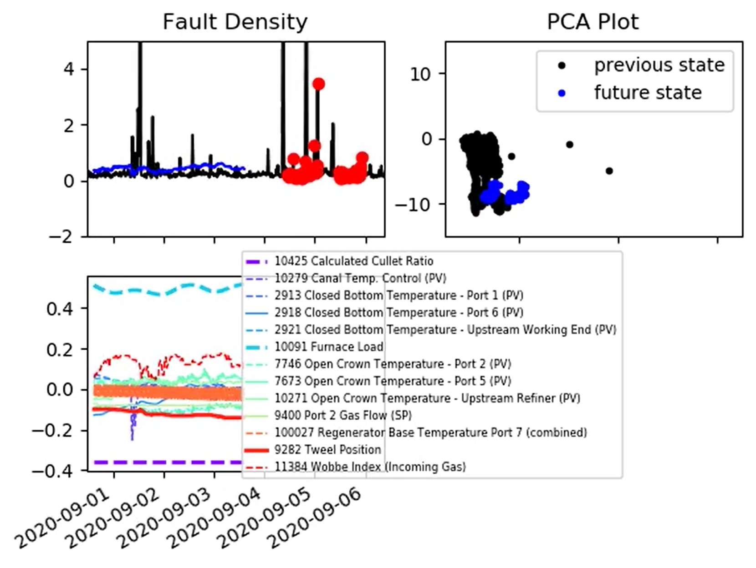
Furnace State – PCA plot
Here a change in furnace load is pushing the furnace into a different state.
The model is initially able to capture the rise in fault density that occurs, but is then pushed beyond data it has seen before and has to adapt as a result.

Slide 15
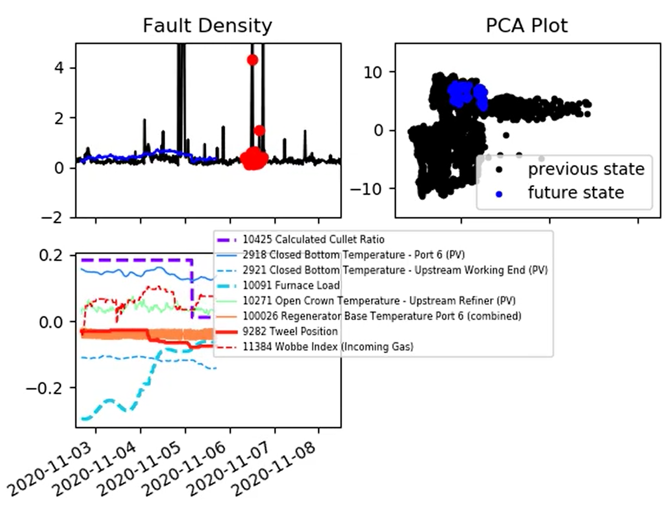
Furnace State – PCA plot
One question; does the PCA plot provide useful information on its own?
For example, furnace state is currently stable and remaining in the same region.

Slide 16
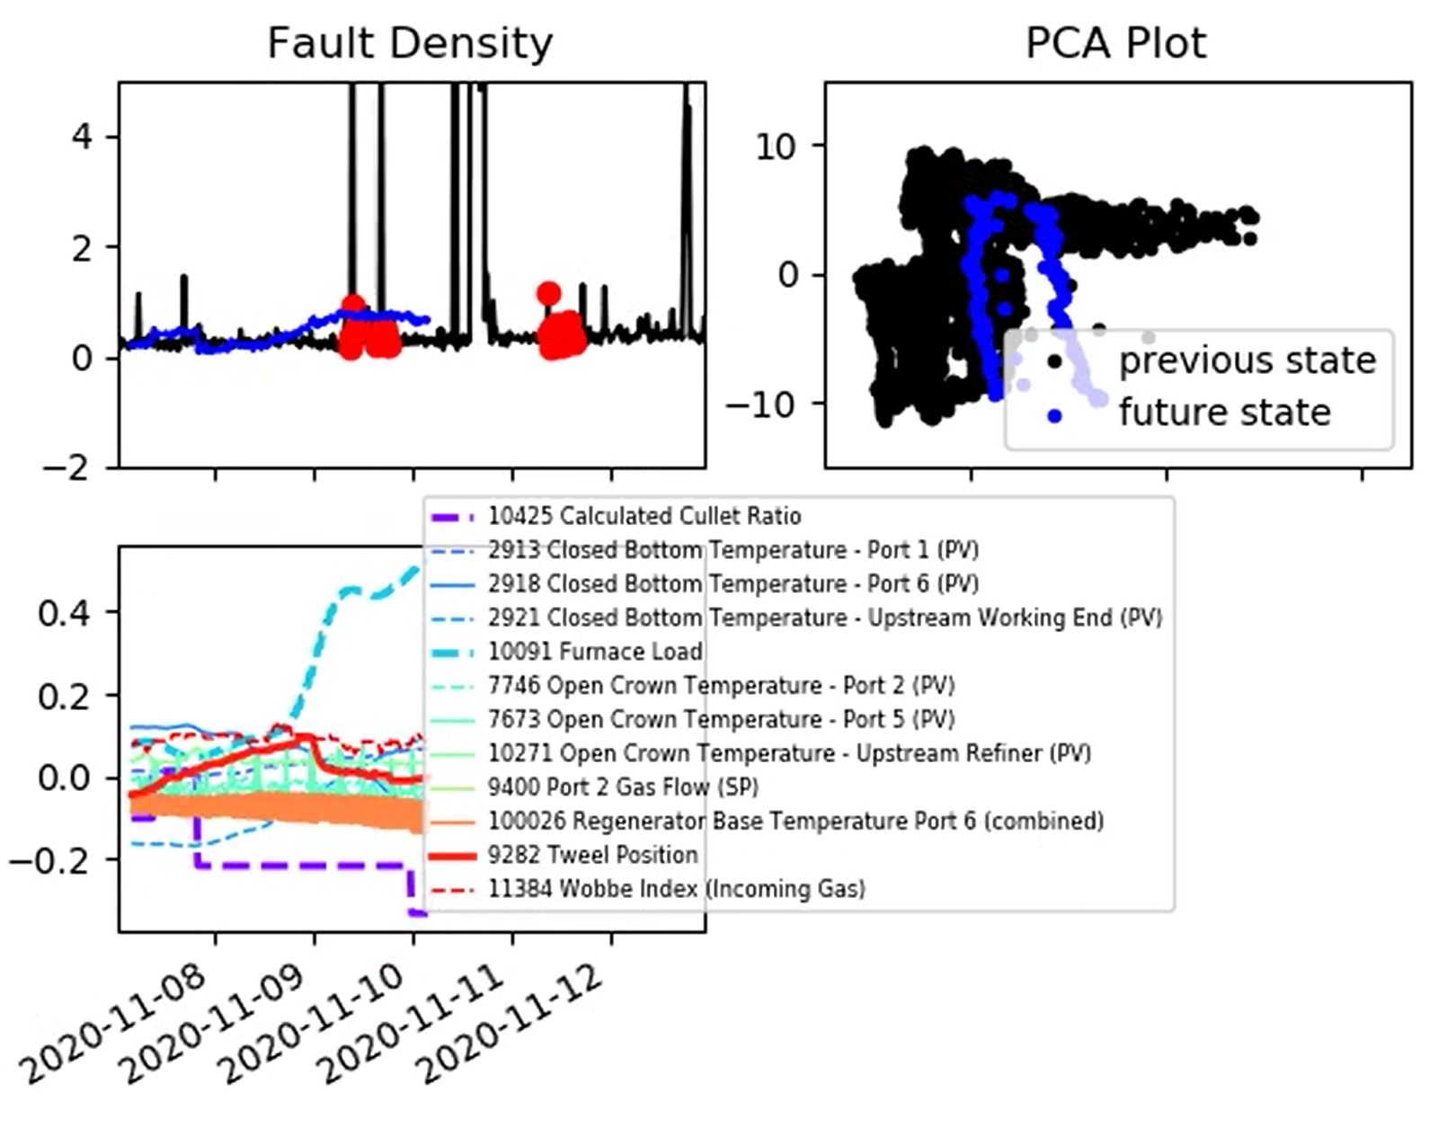
Furnace State – PCA plot
One question; does the PCA plot provide useful information on its own?
For example, furnace state is transitioning into a new region as a result of a change in load.

Slide 17
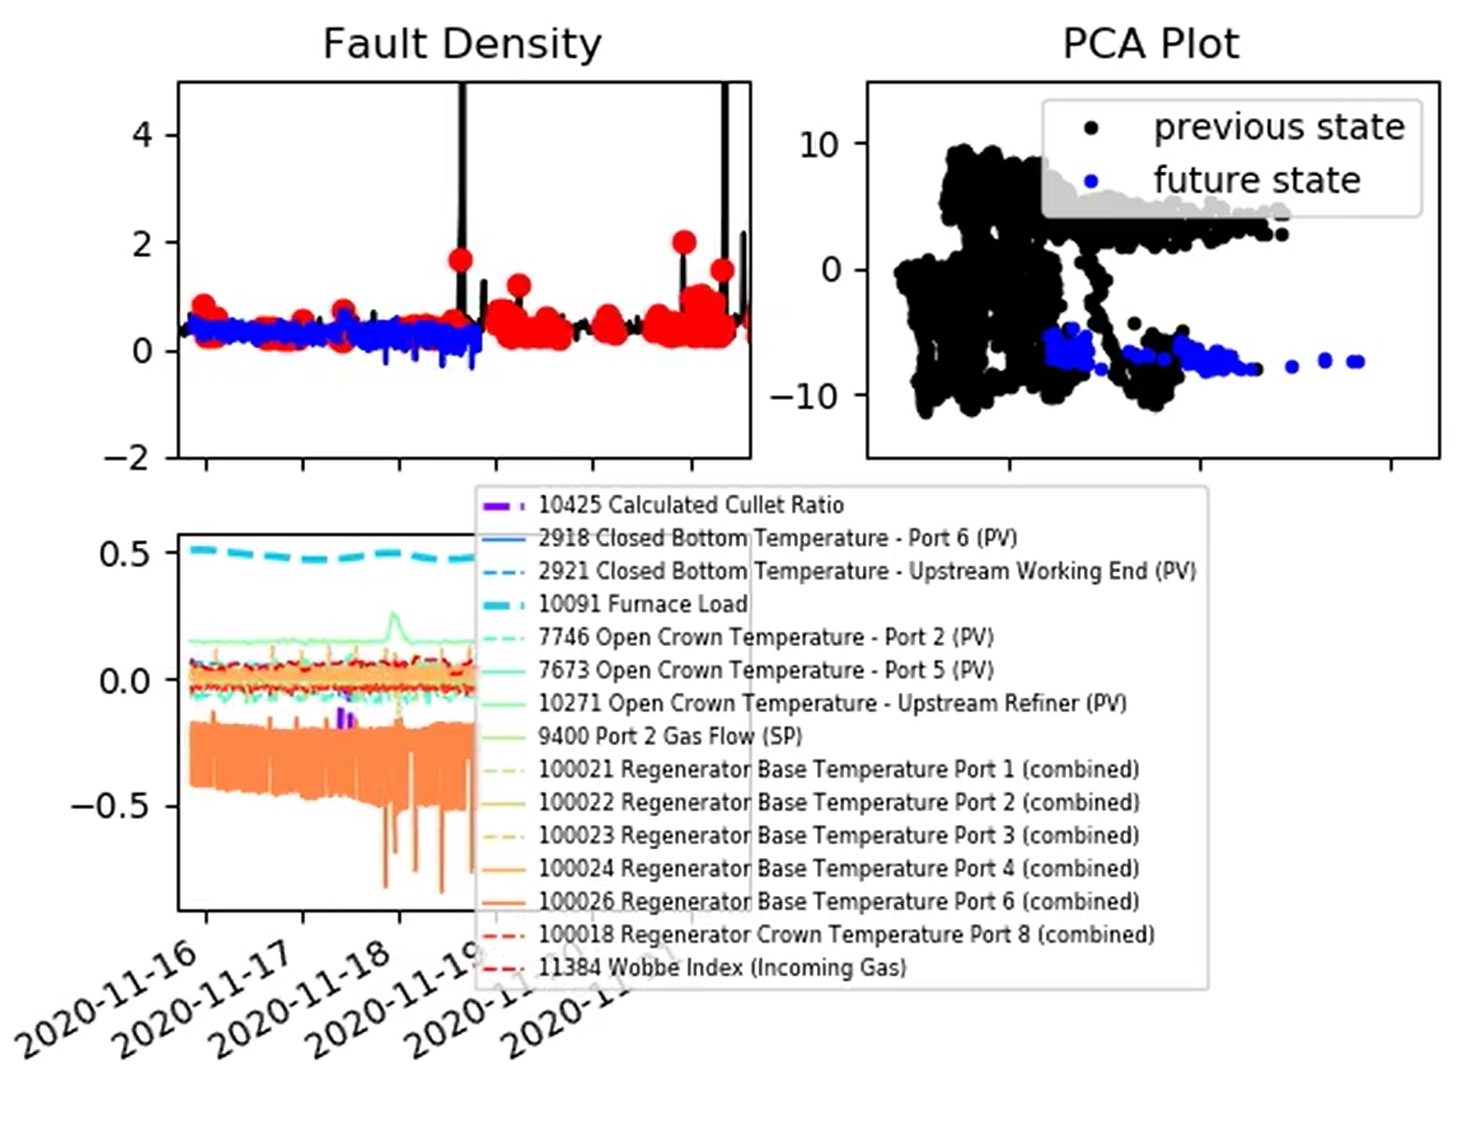
Furnace State – PCA plot
One question; does the PCA plot provide useful information on its own?
For example, outlier behaviour (in this case related to the regenerator base temperature signals).

